Slide 1

Walmart Kaggle Contest
Trip Type Classification

Slide 2
Predict “Trip Type” starting with 6 Features
(Trip Type: categorical id representing the type of shopping trip the customer made)
VisitNumber - an id corresponding to a single trip by a single customer
Weekday - the weekday of the trip
Upc - the UPC number of the product purchased
ScanCount - the number of the given item that was purchased. A negative value indicates a product return.
DepartmentDescription - a high-level description of the item's department
FinelineNumber - a more refined category for each of the products, created by Walmart

Slide 3
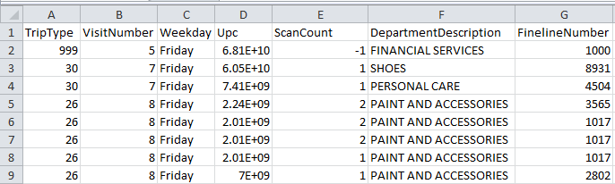
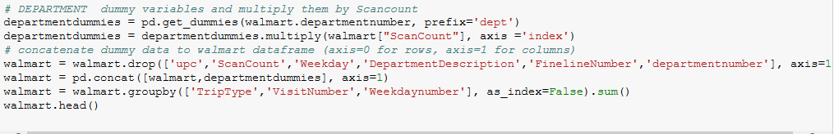
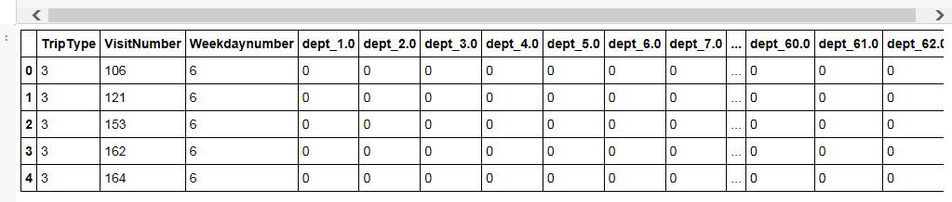
Working with the Data

Slide 4
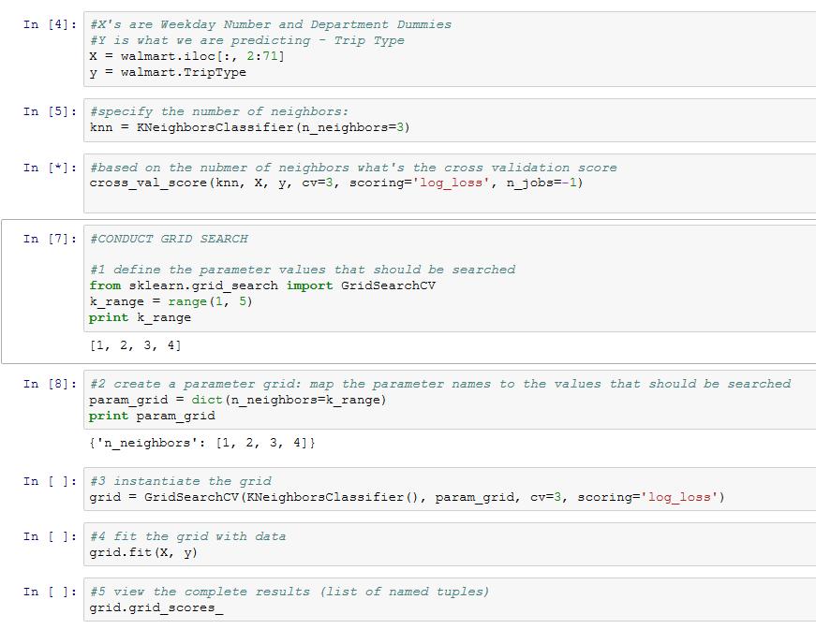
Modeling
K Nearest Neighbor to predict Trip Type

Slide 5
Next Steps
Find optimal model through grid search
Load Test set and run against model
Export results to Kaggle competition

